Slide 1


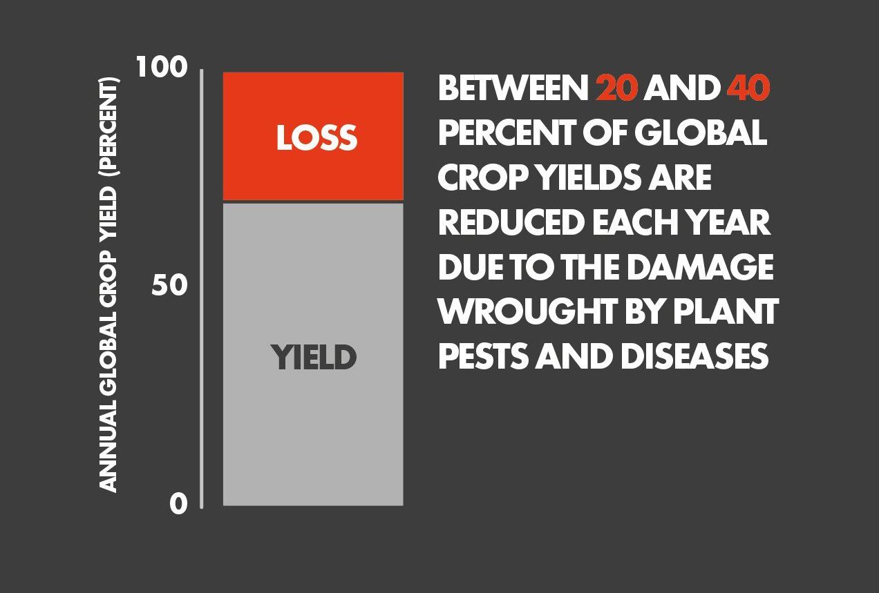
NatureNurture
Designed by EDGE-STREAK
The Problem
Source: Food and Agriculture Organization https://x.com/FAOstatistics/status/780420534786031617

Slide 2

NatureNurture
Designed by EDGE-STREAK
The Problem
Source: Food and Agriculture Organization https://x.com/FAOstatistics/status/780420534786031617
Impact on Agriculture
Reduced harvests can lead to malnutrition and even famine, especially in under-resourced regions.
Crop losses can devastate farmer income and threaten their ability to support themselves and their families.
Diseases can drive up food prices due to decreased supply.
Farmers
Gardeners
Horticulturists
Landscapers

Slide 3
The Problem
Source: Food and Agriculture Organization https://x.com/FAOstatistics/status/780420534786031617
Impact on Agriculture
Reduced harvests can lead to malnutrition and even famine, especially in under-resourced regions.
Crop losses can devastate farmer income and threaten their ability to support themselves and their families.
Diseases can drive up food prices due to decreased supply.
Problem Statement:
Prevent the spread of destructive plant diseases

Slide 4


Impact on Agriculture
Reduced harvests can lead to malnutrition and even famine, especially in under-resourced regions.
Crop losses can devastate farmer income and threaten their ability to support themselves and their families.
Diseases can drive up food prices due to decreased supply.
Problem Statement:
Prevent the spread of destructive plant diseases
Objectives
Diagnose diseases on a plant from a picture
Give users advice on how to treat the disease
Create an accessible and user friendly GUI
Audience
Underdeveloped communities
Farmers
Gardeners
Horticulturists
Landscapers

Slide 5



Problem Statement:
Prevent the spread of destructive plant diseases
Objectives
Audience
Diagnose diseases on a plant from a picture
Give users advice on how to treat the disease
Create an accessible and user friendly GUI
Underdeveloped communities
Farmers
Gardeners
Horticulturists
Landscapers
Programing languages
Frameworks & Libraries
TensorFlow
Keras
OpenCV
Gemini API
Flask
Matplotlib/Seaborn
HTML
CSS
Python
Javascript

Slide 6
Objectives
Audience
Diagnose diseases on a plant from a picture
Give users advice on how to treat the disease
Create an accessible and user friendly GUI
Underdeveloped communities
Farmers
Gardeners
Horticulturists
Landscapers
Programing languages
Frameworks & Libraries
HTML
CSS
Python
Javascript
TensorFlow
Keras
OpenCV
Gemini API
Flask
Matplotlib/Seaborn
App Demonstration
Designed by EDGE-STREAK

Slide 7
Frameworks & Libraries
TensorFlow
Keras
OpenCV
Gemini API
Flask
Matplotlib/Seaborn
1
Programing languages
HTML
CSS
Python
Javascript
App Demonstration
Designed by EDGE-STREAK

Slide 8



App Demonstration
Designed by EDGE-STREAK
Solution Overview
Key Features
Assist gardeners and farmers in identifying plant diseases
Data base of 38 infections
Expected Impact
Image classification
AI Chatbot for Plant Care
Educational Information
Accessibility
User-Friendly Interface
Early Detection
Increased Knowledge
Enhanced Food Security
Accessibility to Expert Knowledge
Inclusivity

Slide 9
App Demonstration
Designed by EDGE-STREAK
Solution Overview
Key Features
Expected Impact
Assist gardeners and farmers in identifying plant diseases
Data base of 38 infections
Image classification
AI Chatbot for Plant Care
Educational Information
Accessibility
User-Friendly Interface
Early Detection
Increased Knowledge
Enhanced Food Security
Accessibility to Expert Knowledge
Inclusivity
Chat GPT
Brainstorming and ideation during project initiation.
Understanding documentation and syntax for libraries like TensorFlow, Keras, and OpenCV.
Clarifying parameters and syntax for training the CNN in TensorFlow/Keras.
Supporting integration of the Gemini API for chatbot functionality.
Assisting in CSS styling for improved user experience.

Slide 10
Expected Impact
Key Features
Early Detection
Increased Knowledge
Enhanced Food Security
Accessibility to Expert Knowledge
Inclusivity
Solution Overview
Image classification
AI Chatbot for Plant Care
Educational Information
Accessibility
User-Friendly Interface
Assist gardeners and farmers in identifying plant diseases
Data base of 38 infections
Chat GPT
Brainstorming and ideation during project initiation.
Understanding documentation and syntax for libraries like TensorFlow, Keras, and OpenCV.
Clarifying parameters and syntax for training the CNN in TensorFlow/Keras.
Supporting integration of the Gemini API for chatbot functionality.
Assisting in CSS styling for improved user experience.
Amazon CodeWhisperer (Amazon Q)
Debugging and resolving issues during development.
Navigating documentation for libraries and frameworks.
Providing insights into CNN model training in TensorFlow/Keras.
Supporting integration of the Gemini API within the web app.
Helping with web app styling using CSS.

Slide 11
Google Gemini
Optimizing the CNN by providing recommendations for performance improvement.
Suggesting helpful YouTube videos based on project needs, significantly aiding in CNN optimization.
Chat GPT
Brainstorming and ideation during project initiation.
Understanding documentation and syntax for libraries like TensorFlow, Keras, and OpenCV.
Clarifying parameters and syntax for training the CNN in TensorFlow/Keras.
Supporting integration of the Gemini API for chatbot functionality.
Assisting in CSS styling for improved user experience.
Amazon CodeWhisperer (Amazon Q)
Debugging and resolving issues during development.
Navigating documentation for libraries and frameworks.
Providing insights into CNN model training in TensorFlow/Keras.
Supporting integration of the Gemini API within the web app.
Helping with web app styling using CSS.

Slide 12
Application of AI Tools
Google Gemini
Brainstorming: Ideas generated during the initial phases.
Development and Debugging: Both ChatGPT and Amazon Q were consulted throughout the development phase.
Model Training: Clarification on setting up and training the CNN.
API Integration: Integrated the Gemini API for chatbot features.
Web Design: Assisted in creating a functional and user-friendly interface.
CNN Optimization: Google Gemini provided valuable resources for optimizing the CNN.
Optimizing the CNN by providing recommendations for performance improvement.
Suggesting helpful YouTube videos based on project needs, significantly aiding in CNN optimization.
Amazon CodeWhisperer (Amazon Q)
Debugging and resolving issues during development.
Navigating documentation for libraries and frameworks.
Providing insights into CNN model training in TensorFlow/Keras.
Supporting integration of the Gemini API within the web app.
Helping with web app styling using CSS.

Slide 13
Application of AI Tools
Google Gemini
Brainstorming: Ideas generated during the initial phases.
Development and Debugging: Both ChatGPT and Amazon Q were consulted throughout the development phase.
Model Training: Clarification on setting up and training the CNN.
API Integration: Integrated the Gemini API for chatbot features.
Web Design: Assisted in creating a functional and user-friendly interface.
CNN Optimization: Google Gemini provided valuable resources for optimizing the CNN.
Optimizing the CNN by providing recommendations for performance improvement.
Suggesting helpful YouTube videos based on project needs, significantly aiding in CNN optimization.
Brainstorming: Creative insights for model design.
Debugging: Identification of bugs and proposed fixes.
Documentation Assistance: Simplifying complex documentation for libraries.
Model Training: Configuration of CNN parameters.
API Integration: Finding methods for integrating the Gemini API.
Web Styling: Suggestions and CSS syntax for UI design.
Optimization: Google Gemini provided targeted resources for enhancement.

Slide 14
Total Use of AI Tools
Brainstorming:
ChatGPT: 70%
Amazon CodeWhisperer: 20%
Google Gemini: 10%
Development:
ChatGPT: 30%
Amazon CodeWhisperer: 50%
Google Gemini: 20%
Documentation:
ChatGPT: 20%
Amazon CodeWhisperer: 30%
Google Gemini: 50%
Application of AI Tools
Brainstorming: Ideas generated during the initial phases.
Development and Debugging: Both ChatGPT and Amazon Q were consulted throughout the development phase.
Model Training: Clarification on setting up and training the CNN.
API Integration: Integrated the Gemini API for chatbot features.
Web Design: Assisted in creating a functional and user-friendly interface.
CNN Optimization: Google Gemini provided valuable resources for optimizing the CNN.
Brainstorming: Creative insights for model design.
Debugging: Identification of bugs and proposed fixes.
Documentation Assistance: Simplifying complex documentation for libraries.
Model Training: Configuration of CNN parameters.
API Integration: Finding methods for integrating the Gemini API.
Web Styling: Suggestions and CSS syntax for UI design.
Optimization: Google Gemini provided targeted resources for enhancement.

Slide 15
Application of AI Tools
Total Use of AI Tools
Brainstorming: Creative insights for model design.
Debugging: Identification of bugs and proposed fixes.
Documentation Assistance: Simplifying complex documentation for libraries.
Model Training: Configuration of CNN parameters.
API Integration: Finding methods for integrating the Gemini API.
Web Styling: Suggestions and CSS syntax for UI design.
Optimization: Google Gemini provided targeted resources for enhancement.
Brainstorming:
ChatGPT: 70%
Amazon CodeWhisperer: 20%
Google Gemini: 10%
Development:
ChatGPT: 30%
Amazon CodeWhisperer: 50%
Google Gemini: 20%
Documentation:
ChatGPT: 20%
Amazon CodeWhisperer: 30%
Google Gemini: 50%
Summary of Tool Usage
ChatGPT was predominantly used during the brainstorming phase for generating ideas and structuring the project, accounting for 70% of usage in that phase. It also played a significant role in documentation, where it helped simplify complex concepts.
Amazon CodeWhisperer was the most utilized tool during the development phase, with 50% usage, providing crucial debugging support and insights into model training.
Google Gemini was less frequently used overall, primarily contributing to optimization recommendations and targeted resources during model training.

Slide 16
Total Use of AI Tools
Summary of Tool Usage
Brainstorming:
ChatGPT: 70%
Amazon CodeWhisperer: 20%
Google Gemini: 10%
Development:
ChatGPT: 30%
Amazon CodeWhisperer: 50%
Google Gemini: 20%
Documentation:
ChatGPT: 20%
Amazon CodeWhisperer: 30%
Google Gemini: 50%
ChatGPT was predominantly used during the brainstorming phase for generating ideas and structuring the project, accounting for 70% of usage in that phase. It also played a significant role in documentation, where it helped simplify complex concepts.
Amazon CodeWhisperer was the most utilized tool during the development phase, with 50% usage, providing crucial debugging support and insights into model training.
Google Gemini was less frequently used overall, primarily contributing to optimization recommendations and targeted resources during model training.
NatureNurture
Designed by EDGE-STREAK

Slide 17
Summary of Tool Usage
NatureNurture
ChatGPT was predominantly used during the brainstorming phase for generating ideas and structuring the project, accounting for 70% of usage in that phase. It also played a significant role in documentation, where it helped simplify complex concepts.
Amazon CodeWhisperer was the most utilized tool during the development phase, with 50% usage, providing crucial debugging support and insights into model training.
Google Gemini was less frequently used overall, primarily contributing to optimization recommendations and targeted resources during model training.
Designed by EDGE-STREAK
Thank You!

